Slide 1

Farzam Asad 258
Manahil Hanif 259
Ali Sultan 232
Amina Liaquat 251
Nauman 228

Slide 2

Introduction
A library is a place where huge collection of books and resources are available which can be accessible by the users.
Library management is a sub-discipline of institutional management that focuses on specific issues faced by libraries and library management professionals. The basic functions of library management include overseeing all library operations, managing the library budget, planning, over seeing fee collection, event planning, and human resource

Slide 3

Purpose of LMS
PURPOSE OF LMS
The purpose of LMS is to manage and track e-learning.
An LMS gives a company a virtual hub where e-learners can access training resources, and its intention is to make training accessible for remote learner while providing a central location for training across an organization.
Increase librarians’ efficiencies.
It saves time.
Customized reports for better management.
Remove manual processes to issue books and maintain records efficiently.
Library administration made simple and easy to operate.

Slide 4

Components
In this proposed system, we use variety of concepts and structures:
Data encapsulation
Data structures
Classes and Structures
Data and Function members
Go-to functions
Single linked lists
Nodes management
Pointers for nodes

Slide 5

CLASS LIBRARY

Slide 6
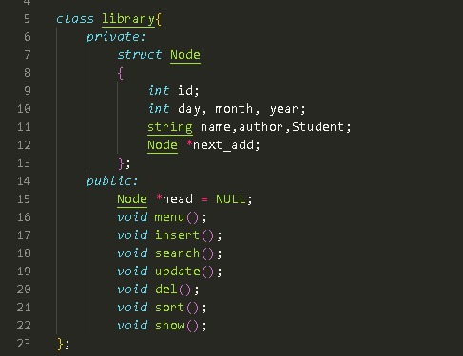
This code snippet defines a class named library which encapsulates the logic for managing a library.
It includes a private structure Node that represents a single book record in the library.
The Node structure has members such as id, day, month, year, name, author, Student, and next _ add (a pointer to the next node in the linked list).
The public section of the class contains function declarations for various operations such as menu(), insert(), search(), update(),del(),sort(), show().
The head member variable of the library class represents the head of the linked list.

Slide 7
MENU FUNCTION

Slide 8
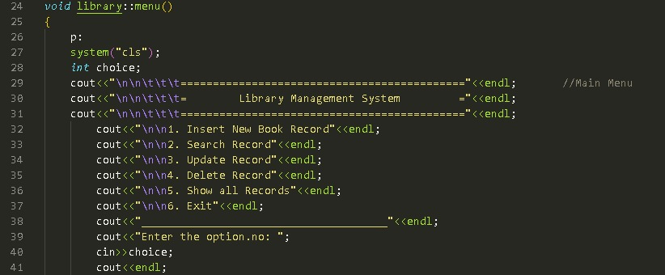
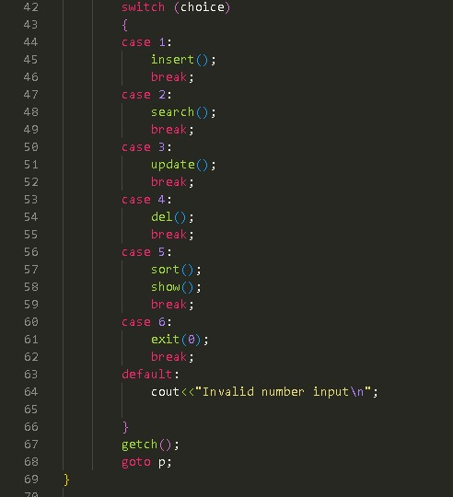
This code snippet defines the menu() function of the library class.
The function displays a menu for
different operations in the library management system.
It takes user input for the desired operation and calls the corresponding function based on the input.
The function includes a loop (goto p;) that allows the user to continue using the system until they choose to exit.

Slide 9
INSERT FUNCTION

Slide 10
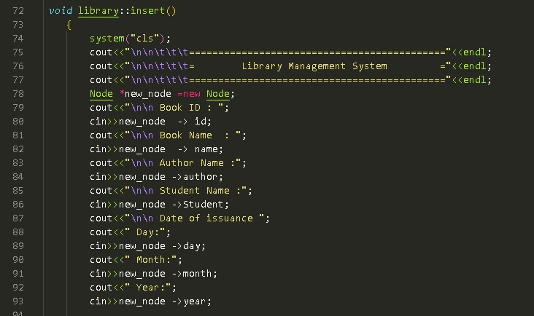
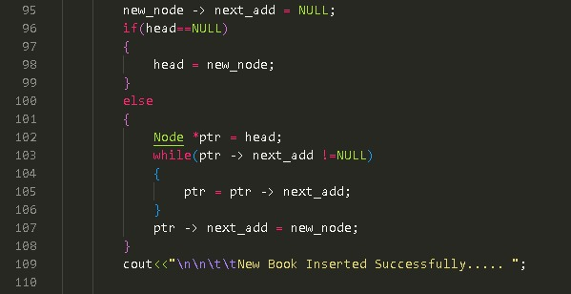
This code snippet defines the insert() function of the library class.
The function is responsible for inserting a new book record into the library.
It prompts the user to enter the details of the book, such as ID, name, author, student, and date of issuance.
A new node is created with the entered information, and the node is inserted at the end of the linked list.
If the linked list is empty (head is NULL), the new node becomes the head.
Otherwise, the new node is appended to the end of the list by traversing through the existing nodes. After successful insertion, a confirmation message is displayed.

Slide 11

DELETE FUNCTION

Slide 12
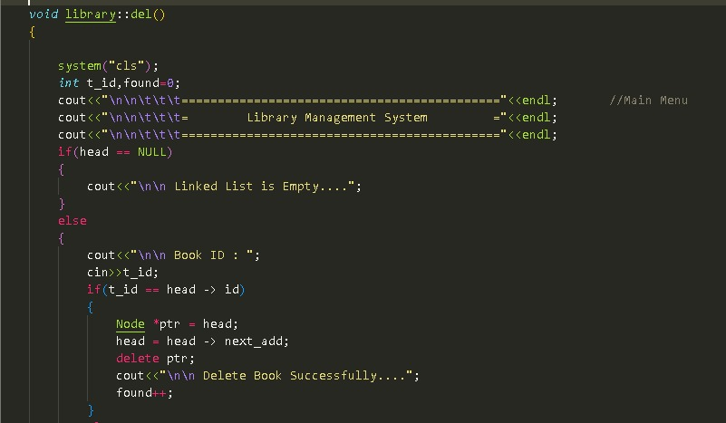
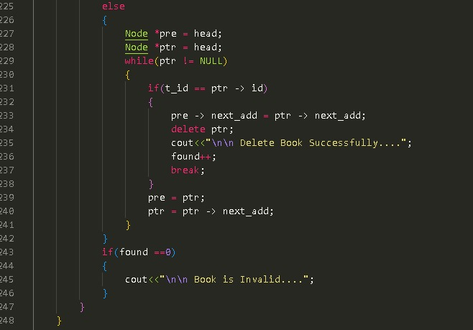
The function allows the user to delete a book record from the library based on the book ID.
This code snippet defines the del() function of the library class.
If the linked list is empty (head is NULL), a message is displayed indicating that the list is empty.
If the linked list is not empty, the user is prompted to enter the book ID they want to delete.
If the book with the specified ID is found at the head of the linked list, the head node is deleted.
If the book with the specified ID is found at a non-head position, the function traverses through the list to find the node before the book to be deleted.
Once found, the link is adjusted to bypass the node to be deleted, and the node is deleted
If no match is found, a message is displayed indicating that the book ID is invalid.

Slide 13
SORT FUNCTION

Slide 14
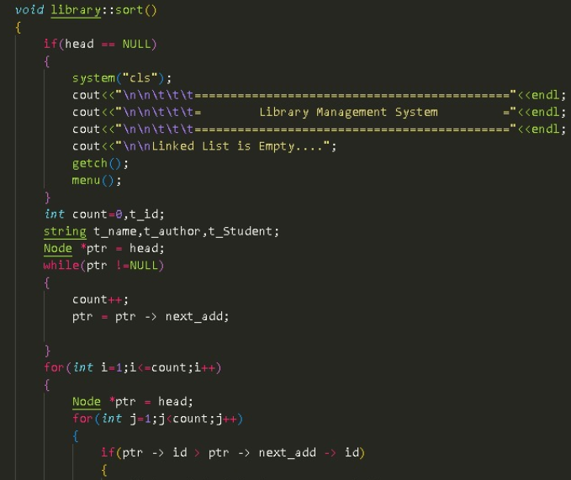
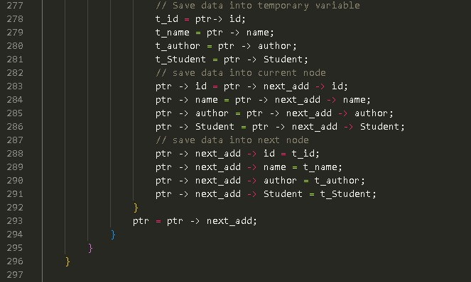
This code snippet defines the sort() function of the library class .
The function sorts the book records in the library based on their IDs in ascending order using the bubble sort algorithm.
It compares adjacent nodes and swaps their positions if the first node has a greater ID than the second node.
The swapping of ID values is accompanied by the swapping of other corresponding attributes (name, author, student, day, month, and year) to maintain consistency.
The process continues until the entire linked list is sorted in ascending order based on the book IDs

Slide 15
SHOW FUNCTION

Slide 16
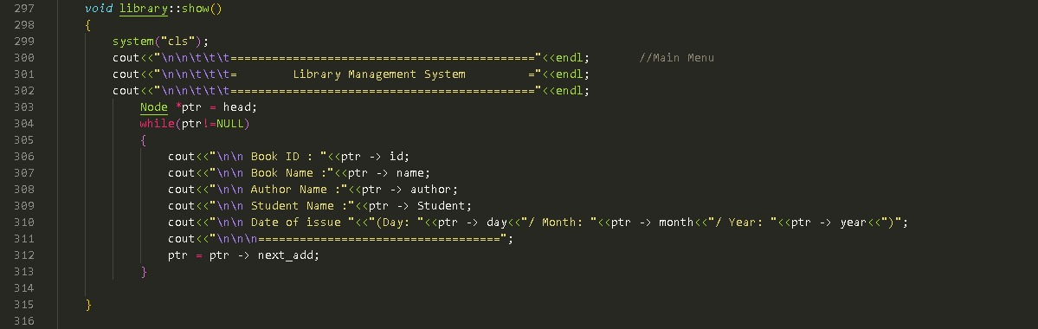
This code snippet defines the show() function of the library class.
The function displays the book records in the library in a tabular format .
If the linked list is empty (head is NULL), a message is displayed indicating that the list is empty .
If the linked list is not empty, the function traverses through the list and prints the details of each book record, including ID, name, author, student, and date of issuance .
The details are displayed in a formatted table with appropriate column headings and separator.

Slide 17
SEARCH FUNCTION

Slide 18
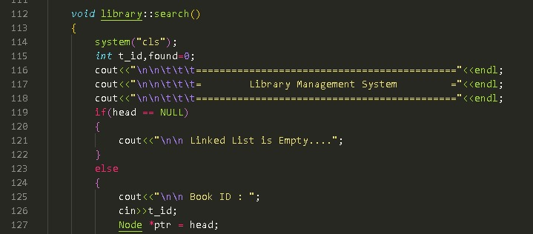
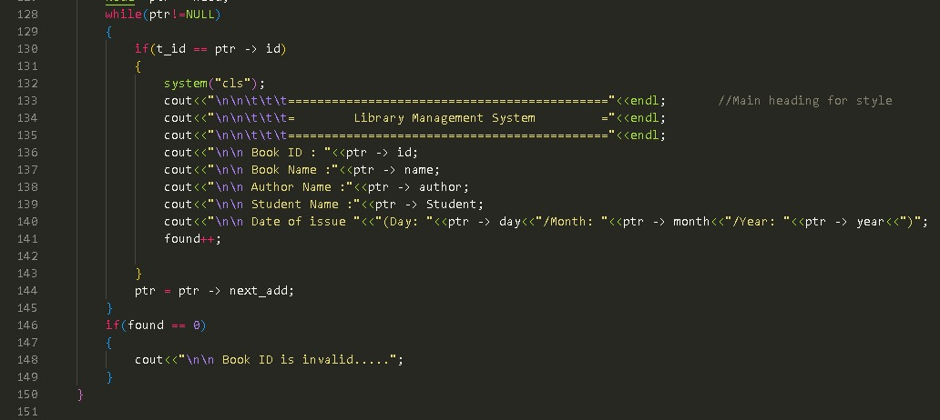
This code snippet defines the search() function of the library class.
The function allows the user to search for a book record in the library based on the book ID.
If the linked list is empty (head is NULL), a message is displayed indicating that the list is empty.
If the linked list is not empty, the user is prompted to enter the book ID they want to search for.
The function then traverses through the linked list to find the book record with a matching ID.
If a match is found, the details of the book (ID, name, author, student, and date of issuance) are displayed. If no match is found, a message is invalid.

Slide 19
MAIN FUNCTION

Slide 20
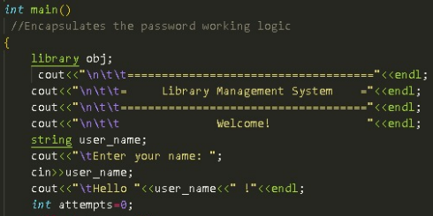
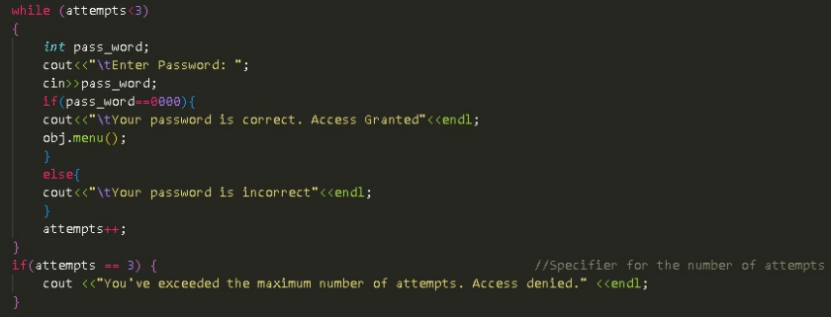
An instance of the library class is created, named obj. This instance will be used to access the library management system's functionality.
A welcome message and a prompt to enter the user's name are displayed.
The user is asked to enter a password. The password is compared with the value 1234 in the if condition.
If the entered password matches 1234, the user is granted access, and the menu function of the library class is called using the obj instance. The menu function displays the main menu of the library management system and handles user interactions.
If the entered password is incorrect, an error message is displayed.
The variable attempts keeps track of the number of password attempts. The loop continues until the number of attempts reaches 3.
If the maximum number of attempts (3) is reached, an error message is displayed, indicating that access has been denied.

Slide 21
CONCLUSION

Slide 22

We believe that this Library Management System will be a valuable addition and will contribute to its success in managing library resources effectively.
Thank you for considering this proposal. We look forward to discussing this opportunity further and addressing any questions or concerns you may have.

